Slide 1

Pixar’s Lamp LUXO
Selin Dinc – Sinem Ozden
CS460 Final Project

Slide 2
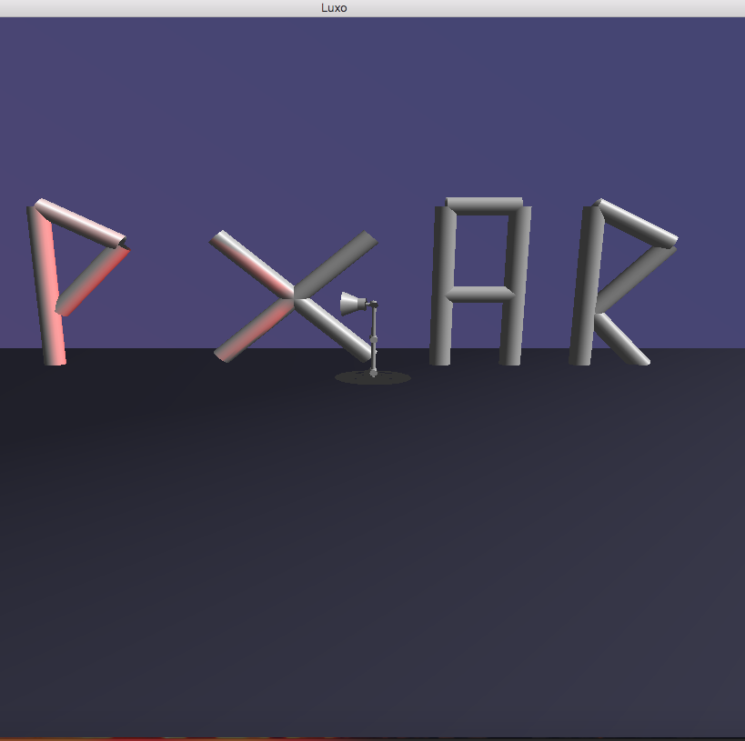
Our Project
We used openGL and C++ for this project.
Our project consists of 3 main parts.
The first part is to draw the lamp and move it.
The second part is to create the background and the lighting.
The third and the last part is to write the “P_XAR”.

Slide 3
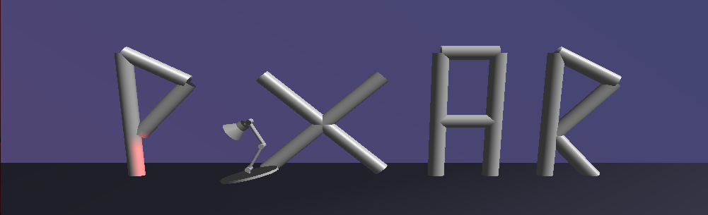
Lamp
We used gluCylinder to make the lamp.
We separated lamp into segments to make it move easier. Lamp does 3 movements.
Forward
Rotate
Jump
Lamp also have a directed red light that also moves with the lamp.

Slide 4
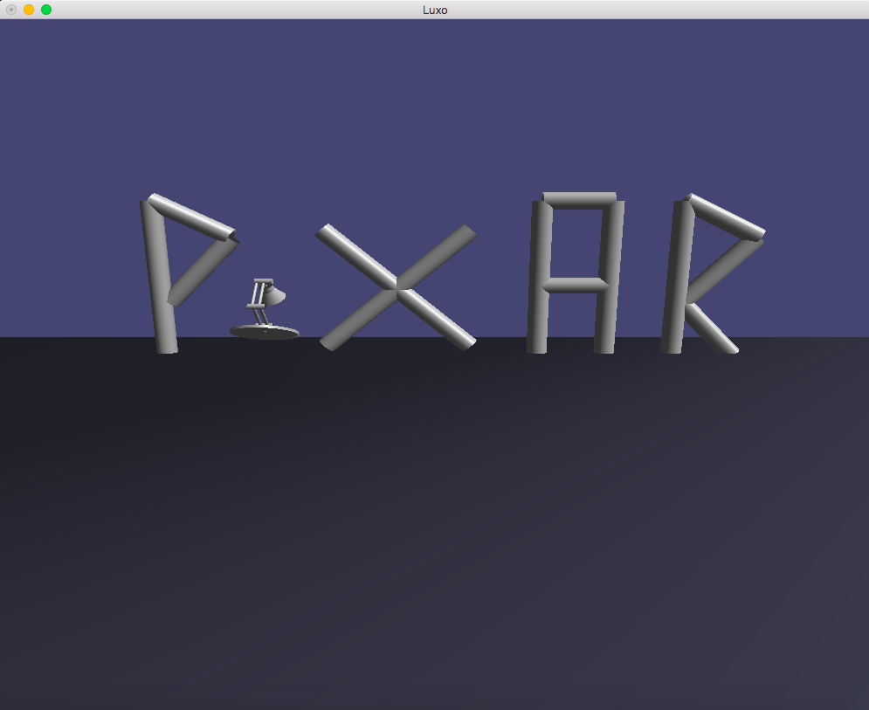
Background
We created a 3D environment for lamp. To achieve this:
We draw a wall and floor for the letters and the lamp stand on.
We used glQuads for the background.
We also set up the camera position, the light brightness and angle of the camera.

Slide 5
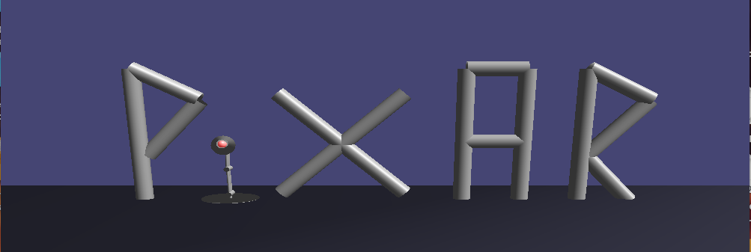
The “P_XAR”
We added the letters by using gluCylinder instead of using a model.

Slide 6


DEMO

Slide 7
Thank you

